Slide 1

Reliability Analysis on a BWR SBO Scenario Using RAVEN
RAVEN Workshop
Presenter: Andrea Alfonsi
IRUG 2016

Slide 2
Outline
Advanced Reliability Analysis
Goal Oriented Sampling
Concept of Limit Surface
Convergence acceleration through ROMs
Reliability Analysis and RAVEN
Available Goal Oriented Samplers
Performing Reliability Analysis within RAVEN: workflow
RAVEN application of Reliability Analysis on a BWR SBO scenario

Slide 3
Reliability Analysis: INTRODUCTION

Slide 4
Reliability Analysis: a quick introduction
Reliability theory evaluates the failure probability of a system given an interval of time
Failure is an “event”
Goal is to forecast/assess the failure events of a given population or the event failure probability
Main goal
Compute the failure probability

Slide 5
Reliability Analysis: Goal-oriented sampling
The evaluation of the failure probability might be computationally challenging, if traditional once-through sampling is employed:
Rare events (low probability) require an enormous number of input space explorations:
Computing a failure probability of 10⁻⁶ would require millions of Monte Carlo samples
Information contained in the evaluated histories is not used to inform the sampling strategy:
System response depends on many variables but often few are really important
Adaptive Sampling based on Reliability (Limit) Surface search

Slide 6
Reliability Analysis: Limit Surface Concept
The limit surface can be described as the hyper-surface that classifies the input space with respect transition regions:
The locus of points that divides the input domain with respect a boolean response (e.g. failure/success)
System Response:
The goal function is an object that is defined as a part of the system outcome space. In a safety context, the goal function usually represents the success or failure (transition) of the system.

Slide 7
Reliability Analysis: Limit Surface Concept
Let’s consider as the transition surface in the output space with respect to the goal function
If the system evolution is represented by
It is possible to identify the set of pairs
Stochastic Parameters
Initial Conditions
in the input space, which leads the system outcome to match:

Slide 8
Reliability Analysis: Limit Surface Search
Training on initial small number of sampled points
A fine grid is classified (failure or success) based on an user-specified surrogate model (sampling of the surrogate)
The limit surface is identified by the location of transition between failure/success
The furthest point on the limit surface from any other already tested point is chosen to test the classifier (convergence test)
Process iterates (2➔4) until the limit surface converges
Failure
Limit surface
Success
Next point

Slide 9
Reliability Analysis: ROMs
For the Adaptive Sampling based on the Reliability (Limit) Surface search, special types of ROMs called “classifiers” are used:
A model (set of equations) that identifies to which category an object belongs in the feature (input) space
Let’s consider again a set of N data points
Based on the goal function :
Build a surrogate model of type “classifier”
Reduced Order Model
Boolean vector
In RAVEN, these ROMs are used as acceleration schemes for goal oriented sampling strategies ➔ they can be used to predict the location of the reliability (limit) surface

Slide 10
Reliability Analysis and RAVEN

Slide 11
Reliability Analysis and RAVEN: Samplers
RAVEN has 2 ways to perform Reliability Analysis based on Limit Surface Search:
Adaptive Sampler
Adaptive DET Sampler
Available
Available
All Coupled Codes
RELAP5-3D, MAAP5 and RELAP7 only

Slide 12
Reliability Analysis: Limit Surface Workflow
Define the distributions. Distributions are used to:
Weigh the error estimation
Generate a probability-weighted metric for grid construction
Determine the probability of being inside one of the regions identified by the limit surface
Define the surrogate model to be used as the accelerator (of type Boolean or discrete)
Define the adaptive sampler:
Convergence control and grid
Import the acceleration ROM
Associate the distribution with the variables
Define a step
Post-process the data to compute the failure probability

Slide 13
Reliability Analysis on a BWR SBO scenario

Slide 14
BWR SBO Scenario: Overview
Plant considered: BWR with Mk.I containment
Test case: Loss of Offsite Power (LOOP) + Loss of Diesel Generators
Objectives:
Evaluate impact of power uprate on LOOP+SBO accident scenario
Show capabilities of simulation based Probabilistic Risk Assessment (PRA) through RISMC

Slide 15
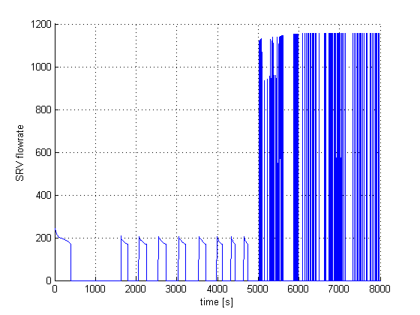
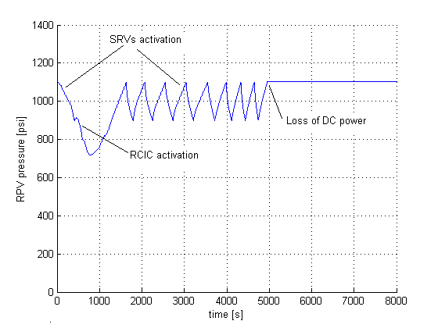
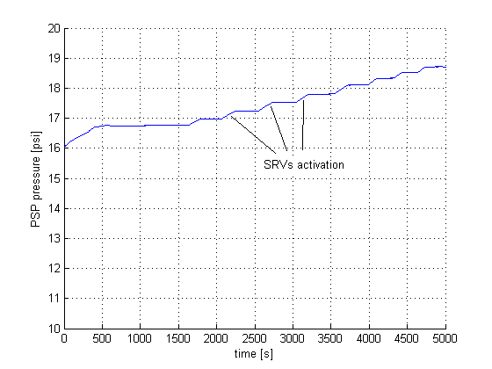
BWR SBO Scenario: Key results
100% Power
120% Power
Notes:
Scenario: LOOP + loss of DGs
3 recovery strategies: off-site power recovery, DG recovery, FW recovery
After loss of DGs, cooling is provided by RCIC/HPCI (mid figure); pressure control provided by SRV (left figure).
Torus pool temperature increases at each SRV activation (right figure).
When pool TH limits are reached, the RPV is depressurized; no cooling can be provided other than FW if available

Slide 16
Workflow in RAVEN
Sample the RELAP5-3D model and create a database
Use generated data to seed the Adaptive Sampling Step
Compute failure probability from converged Solution

Slide 17
Exercise 1: Create a data set to seed the Adaptive Sampler

Slide 18
1 – Sample a Model to seed the Adaptive Sampler
Distributions
Models
Samplers
Databases
DataObjects
Steps
<Distributions>
<Uniform name=’DGrecDist'>
<upperBound>28800</upperBound>
<lowerBound>0.0</lowerBound>
</Uniform>
<Uniform name=’DGrecDist'>
<upperBound>28800</upperBound>
<lowerBound>0.0</lowerBound>
</Uniform>
<!-- cont. →
</Distributions>
Lower and Upper bounds

Slide 19
1 – Sample a Model to seed the Adaptive Sampler
Distributions
Models
Samplers
Databases
DataObjects
Steps
Code Interface Type
<Models>
<Code name=’MyRelap5' subType=’Relap5’>
<executable>path/to/relap5</executable>
<alias variable=”failureTemp”>0000503:1</alias>
</Code>
</Models>
Executable location and name
Alias to have a more readable variable naming

Slide 20
1 – Sample a Model to seed the Adaptive Sampler
Distributions
Models
Samplers
Databases
DataObjects
Steps
<Samplers>
<Stratified name=’LHS_Sampler'>
<variable name='0000200:1'>
<distribution>DGfailDist</distribution>
<grid type='CDF’ construction='equal' steps='4000’>0.0 1.0</grid>
</variable>
<variable name='0000579:6'>
<distribution>DGrecDist</distribution>
<grid type='CDF’ construction='equal' steps='4000’>0.0 1.0</grid>
</variable>
<!-- cont. -->
</Stratified>
</Samplers>
<variable name>
<distribution>
<grid points>

Slide 21
1 – Sample a Model to seed the Adaptive Sampler
Distributions
Models
Samplers
Databases
DataObjects
Steps
<Databases>
<HDF5 name=’LHS_MC_database’ readMode=’overwrite'/>
</Databases>
<DataObjects>
<PointSet name=’FinalConditions'>
<Input>
0000582,0000583,0000597,0000596,0000200,
0000579,0000578,0000575,20508701,20508801,
failureTemp,0000588
</Input>
<Output>
timeof_692,timeof_578,timeof_591,timeof_672,cntrlvar_67,timeof_679
</Output>
</PointSet>
</DataObjects>
Overwrite or open in read mode?

Slide 22
1 – Sample a Model to seed the Adaptive Sampler
Distributions
Models
Samplers
Databases
DataObjects
Steps
<Steps>
<MultiRun name='FirstMRun'>
<Input class=’Files' type=‘' >X11.i</Input>
<Input class=’Files' type=‘' >tpfh2o</Input>
<Model class='Models' type=’Code’ >MyRelap</Model>
<Sampler class='Samplers' type=’Stratified' >Grid_function</Sampler>
<Output class='DataObjects’ type=’PointSet’ >FinalConditions</Output>
<Output class='Databases' type='HDF5' >LHS_MC_database</Output>
</MultiRun>
</Steps>
Model file
Step
Database
Model info
Sampler
DataObjects

Slide 23
Exercise 2: Use generated data to seed the Adaptive Sampling Step and perform Limit Surface search

Slide 24
2- Use data to seed the Adaptive Sampling Step
Models
Functions
Samplers
Databases
DataObjects
Steps
<Models>
<Code name=’MyRelap5' subType=’Relap5’>
<executable>path/to/relap5</executable>
<alias variable=”failureTemp”>0000503:1</alias>
</Code>
<ROM name=’AccelerationROM' subType='SciKitLearn'>
<Features>
0000582,0000583,0000597,0000596,
0000200,0000579,0000578,0000575,
20508701,20508801,failureTemp,0000588
</Features>
<Target>goalFunction</Target>
<SKLtype>svm|SVC</SKLtype>
<kernel>rbf</kernel>
<C>10.0</C>
</ROM>
</Models>
Kernel Type
Penalty parameter of the error term

Slide 25
2- Use data to seed a Goal Oriented Sampling
Models
Functions
Samplers
Databases
DataObjects
Steps
<Functions>
<External name=’goalFunction’ file= ‘goalFunctionWorkshop’>
<variables>
failureTemp,cntrlvar_67
</variables>
</External>
</Functions>
Variables that are needed for the evaluation
def __residuumSign(self):
if self.cntrlvar_67 >= self.failureTemp:
return -1
else:
return 1
Transition definition:
1 -> success
-1 -> failure

Slide 26
2- Use data to seed the Adaptive Sampling Step
Models
Functions
Samplers
Databases
DataObjects
Steps
<Samplers>
<LimitSurfaceSearch name=’workshopAdaptive’>
<ROM class='Models' type='ROM’>accelerated_ROM</ROM>
<Function class='Functions' type='External’>goalFunction</Function>
<TargetEvaluation class='DataObjects' type=’PointSet'>
outAdaptive
</TargetEvaluation>
<Convergence
limit='3000'
forceIteration='False'
weight='value'
persistence='25'>
1e-4
</Convergence>
<variable name='0000200:1’><distribution>DGfailDist</distribution></variable>
<variable name='0000579:6’><distribution>DGrecDist</distribution></variable>
<!-- cont. -->
</LimitSurfaceSearch>
</Samplers>
Max Iterations
Goal function
Force Iteration until limit
Error Weighting: CDF or Value
Tolerance

Slide 27
2- Use data to seed a Goal Oriented Sampling
Models
Functions
Samplers
Databases
DataObjects
Steps
<Databases>
<HDF5 name='out_db_adaptive' directory=’DataBaseStorage/'/>
<HDF5 name=’LHS_MC_database’ readMode=’read’/>
</Databases>
<DataObjects>
<PointSet name='outAdaptive'>
<Input>
0000582,0000583,0000597,0000596,0000200,
0000579,0000578,0000575,20508701,20508801,
failureTemp,0000588
</Input>
<Output>
cntrlvar_67
</Output>
</PointSet >
<PointSet name=’limitSurface'>
<Input>0000582,0000583,0000597,0000596,0000200,0000579,0000578,
0000575,20508701,20508801,failureTemp,0000588</Input>
<Output>goalFunction</Output>
</PointSet >
</DataObjects>
Limit Surface Container

Slide 28
2- Use data to seed a Goal Oriented Sampling
Models
Functions
Samplers
Databases
DataObjects
Steps
<Steps>
<IOStep name=’load_seed_dataset'>
<Input class='Databases' type='HDF5' >LHS_MC_database</Input>
<Output class='DataObjects’ type='TimePointSet'>outAdaptive</Output>
</IOStep>
<MultiRun name=’GoalOrientedStep'>
<Input class=’Files' type=‘' >X11.i</Input>
<Input class=’Files' type=‘' >tpfh2o</Input>
<Model class='Models' type=’Code’ >MyRelap</Model>
<Sampler class='Samplers' type=’LimitSurfaceSearch’>workshopAdaptive</Sampler>
<Output class='DataObjects’type=’PointSet’ >outAdaptive</Output>
<Output class='Databases' type='HDF5' >out_db_adaptive</Output>
<SolutionExport class='DataObjects’type=’PointSet’>
limitSurface
</SolutionExport >
</MultiRun>
</Steps>

Slide 29
Exercise 3: Compute failure probability from Converged solution

Slide 30
3 –Failure Probability from Converged Solution
Models
DataObjects
Steps
<Models>
<PostProcessor name=’limitSurfaceIntegral' subType=’LimitSurfaceIntegral’>
<integralType>MonteCarlo</integralType>
<seed>20021986</seed>
<target>goalFunction</target>
<variable name='0000200:1’><distribution>DGfailDist</distribution></variable>
<variable name='0000579:6’><distribution>DGrecDist</distribution></variable>
<!-- cont. -->
</PostProcessor >
</Models>
Type of Integration
Feature space

Slide 31
3 –Failure Probability from Converged Solution
Models
DataObjects
Steps
<DataObjects>
<PointSet name=’limitSurface'>
<Input>
0000582,0000583,0000597,0000596,0000200,0000579,0000578,
0000575,20508701,20508801,failureTemp,0000588
</Input>
<Output>goalFunction</Output>
</PointSet >
</DataObjects>
Previously generated Limit Surface

Slide 32
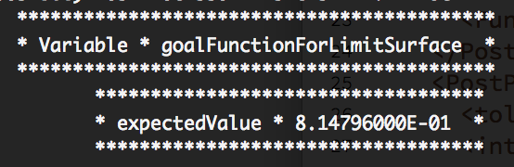
3 –Failure Probability from Converged Solution
Models
DataObjects
Steps
<Steps>
<PostProcess name=’computeFailureProbability'>
<Input class='DataObjects' type=’PointSet' >limitSurface</Input>
<Model class=’Models’ type=’PostProcessor'>limitSurfaceIntegral</Output>
<Output class=’Files’ type=‘'>LimitSurfaceWeighted_out.csv</Output>
</PostProcess >
</Steps>
Step
OutputFile
LimitSurface
Probability

Slide 33
Thank you Questions?

